Slide 1
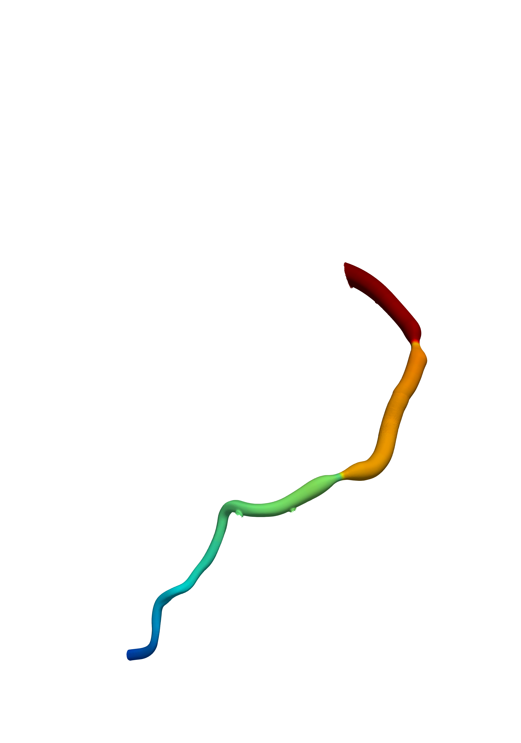
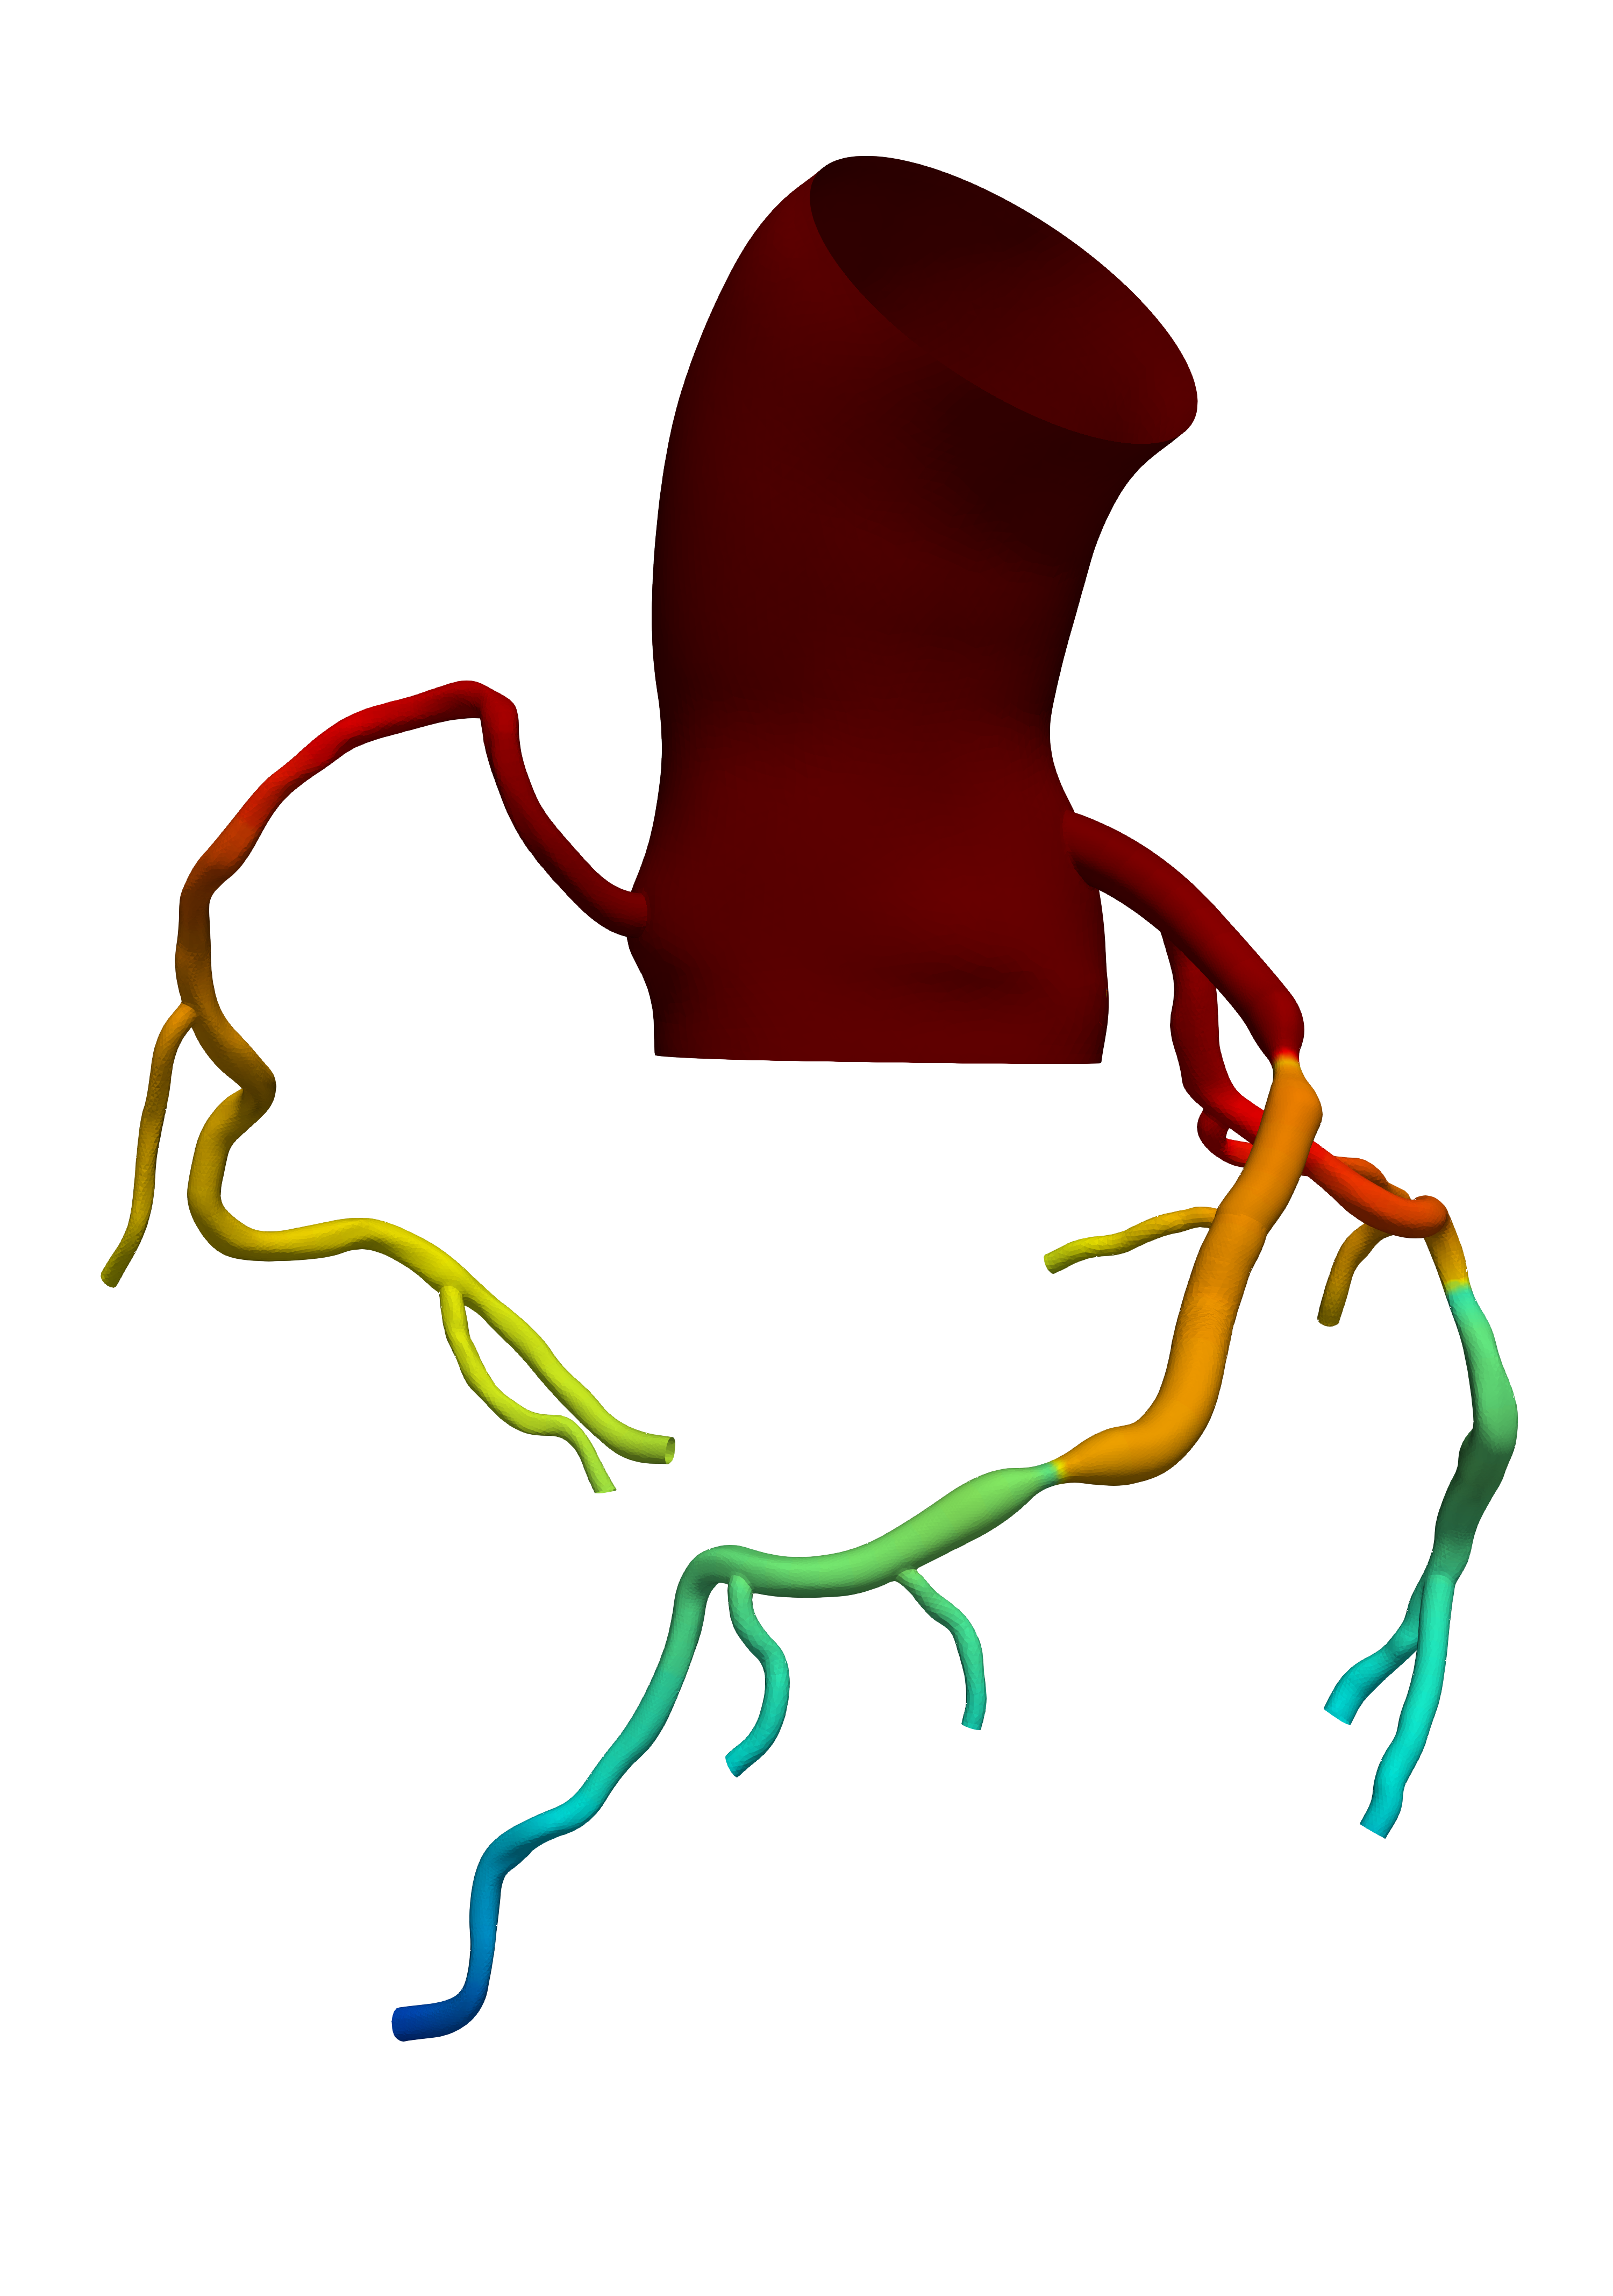
(a) Only S₂ is stented
FFR = 0.87
FFR = 0.86
FFR = 0.78

Slide 2
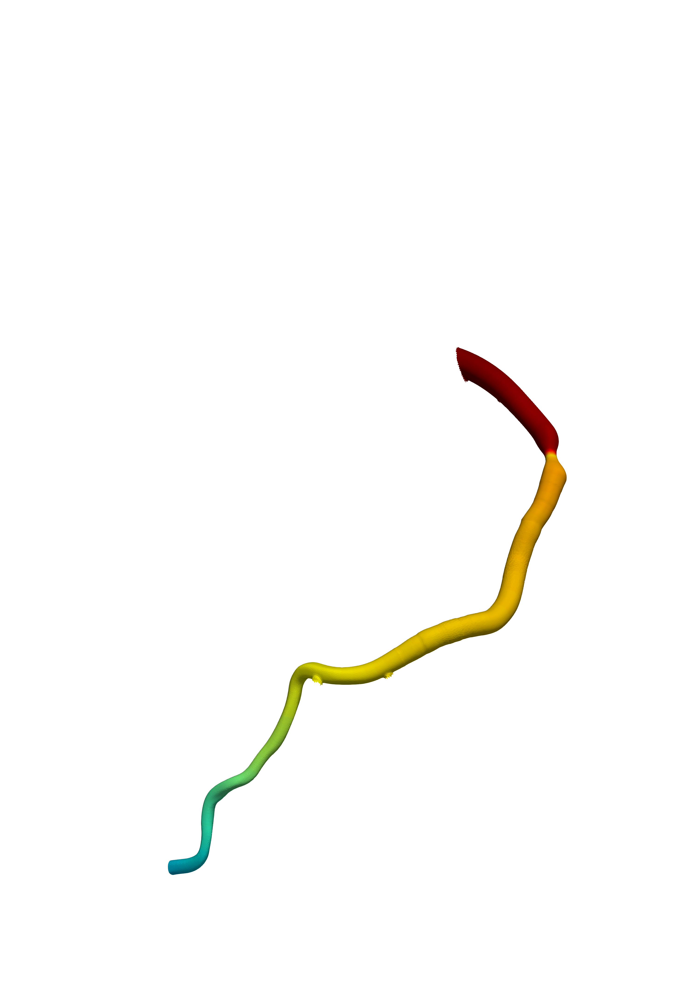
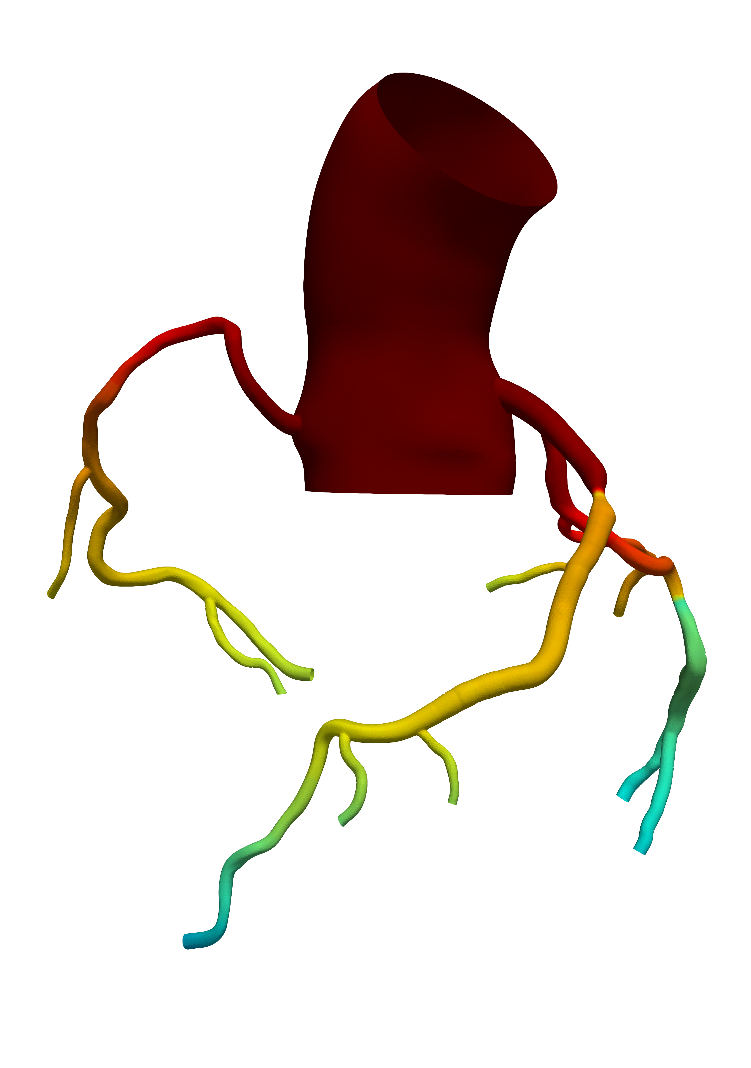
(c) S₂ and S₃ are stented
FFR = 0.87
FFR = 0.85
FFR = 0.84

Slide 3
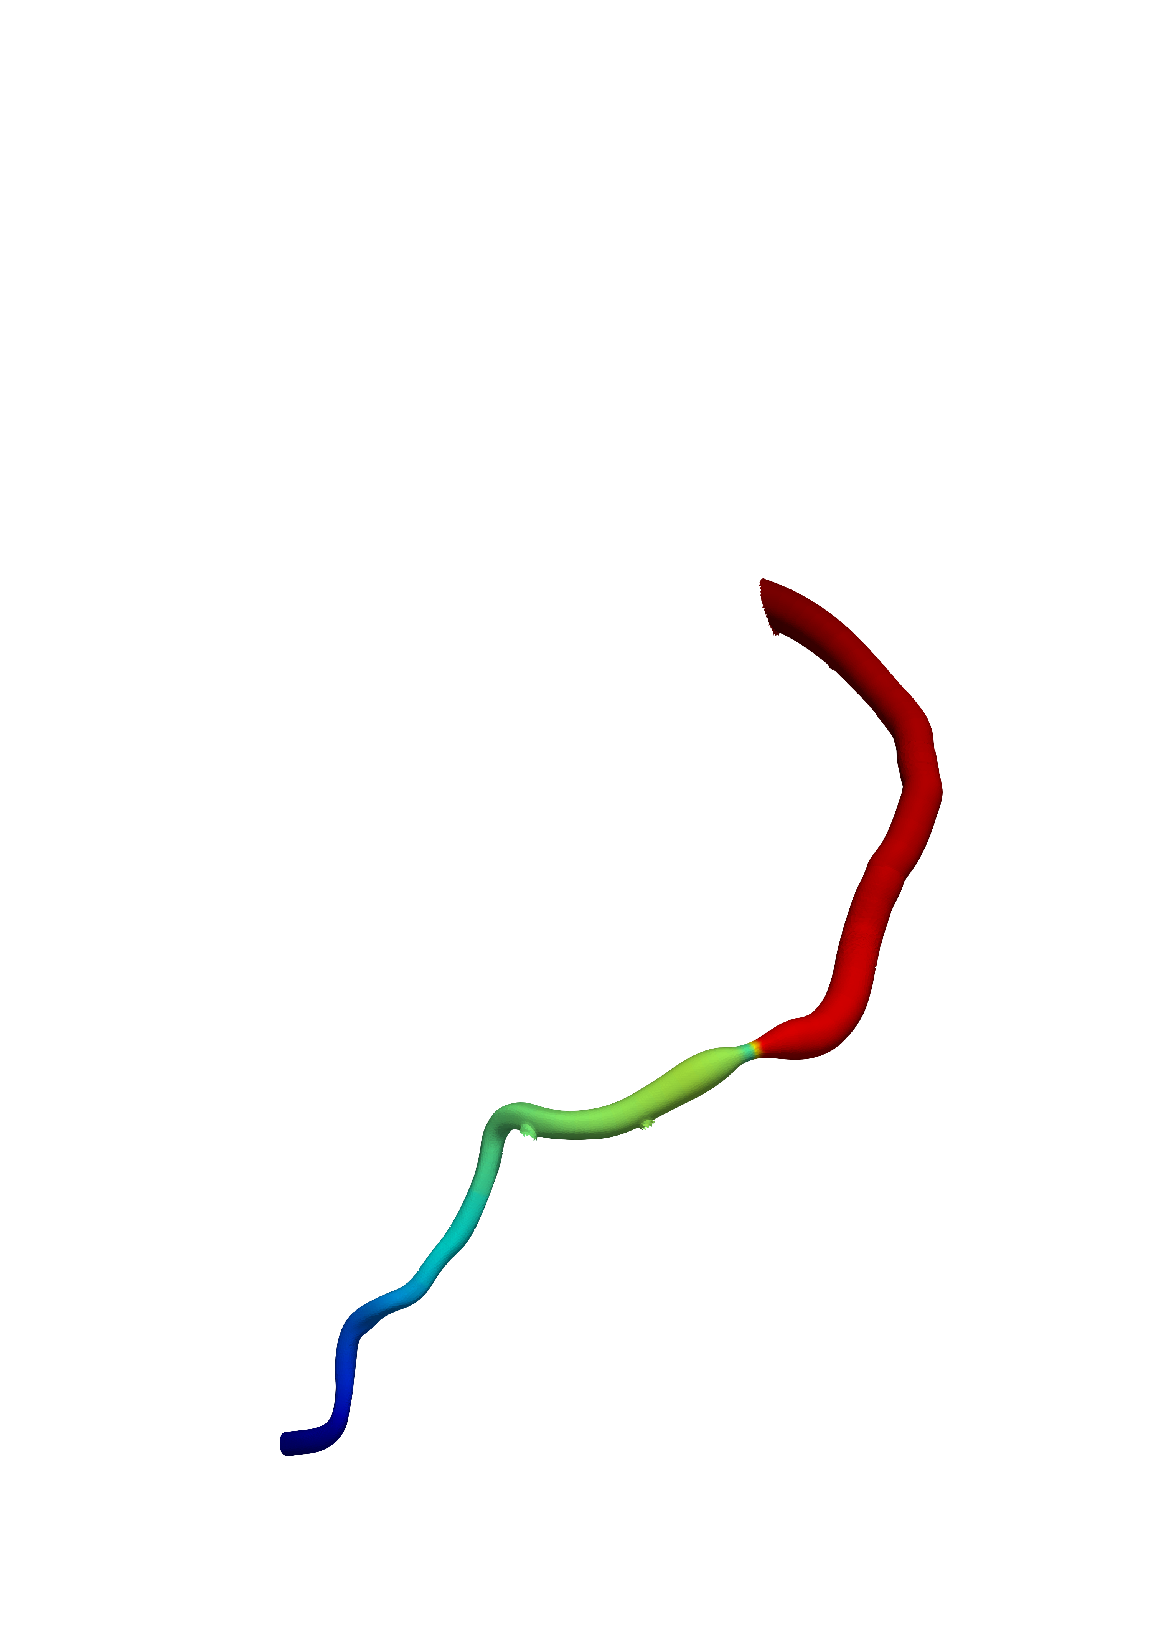
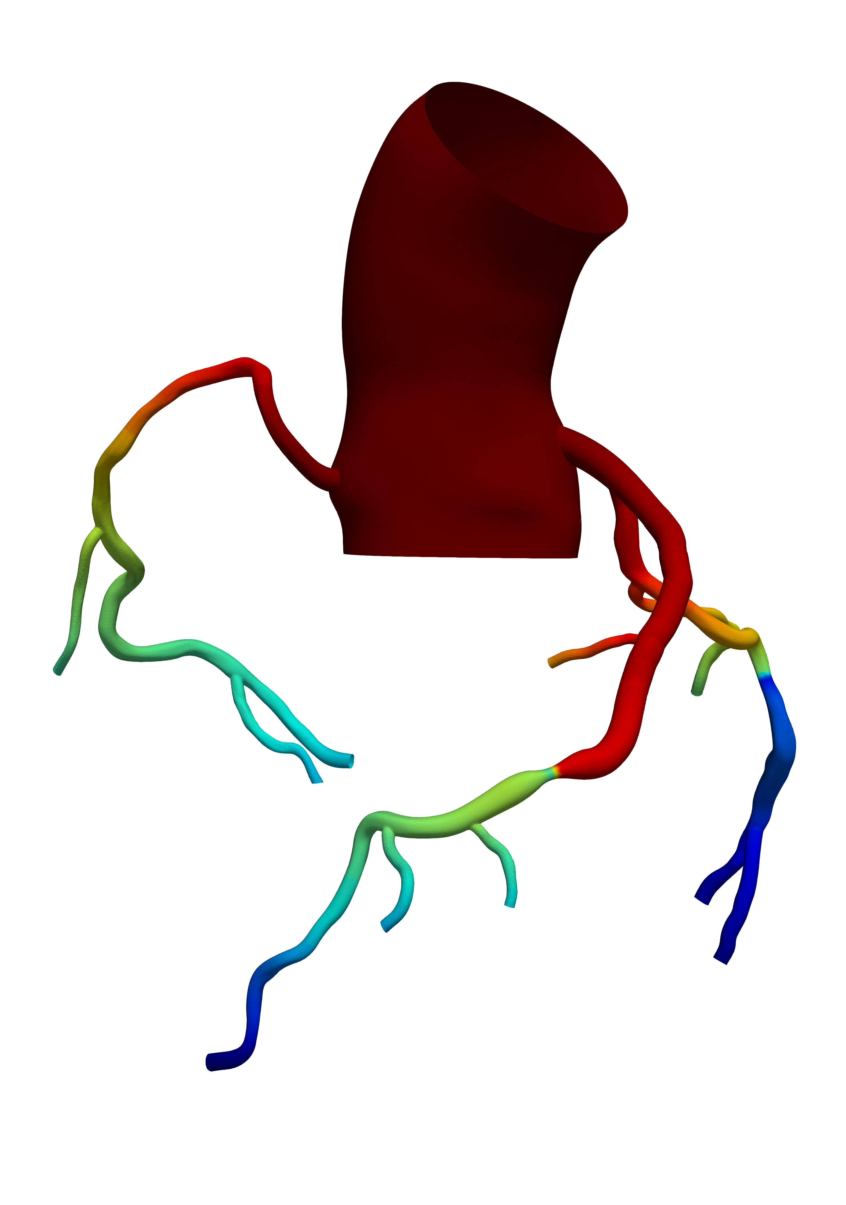
(b) S₁ and S₂ are stented
FFR = 0.98
FFR = 0.97
FFR = 0.88

Slide 4
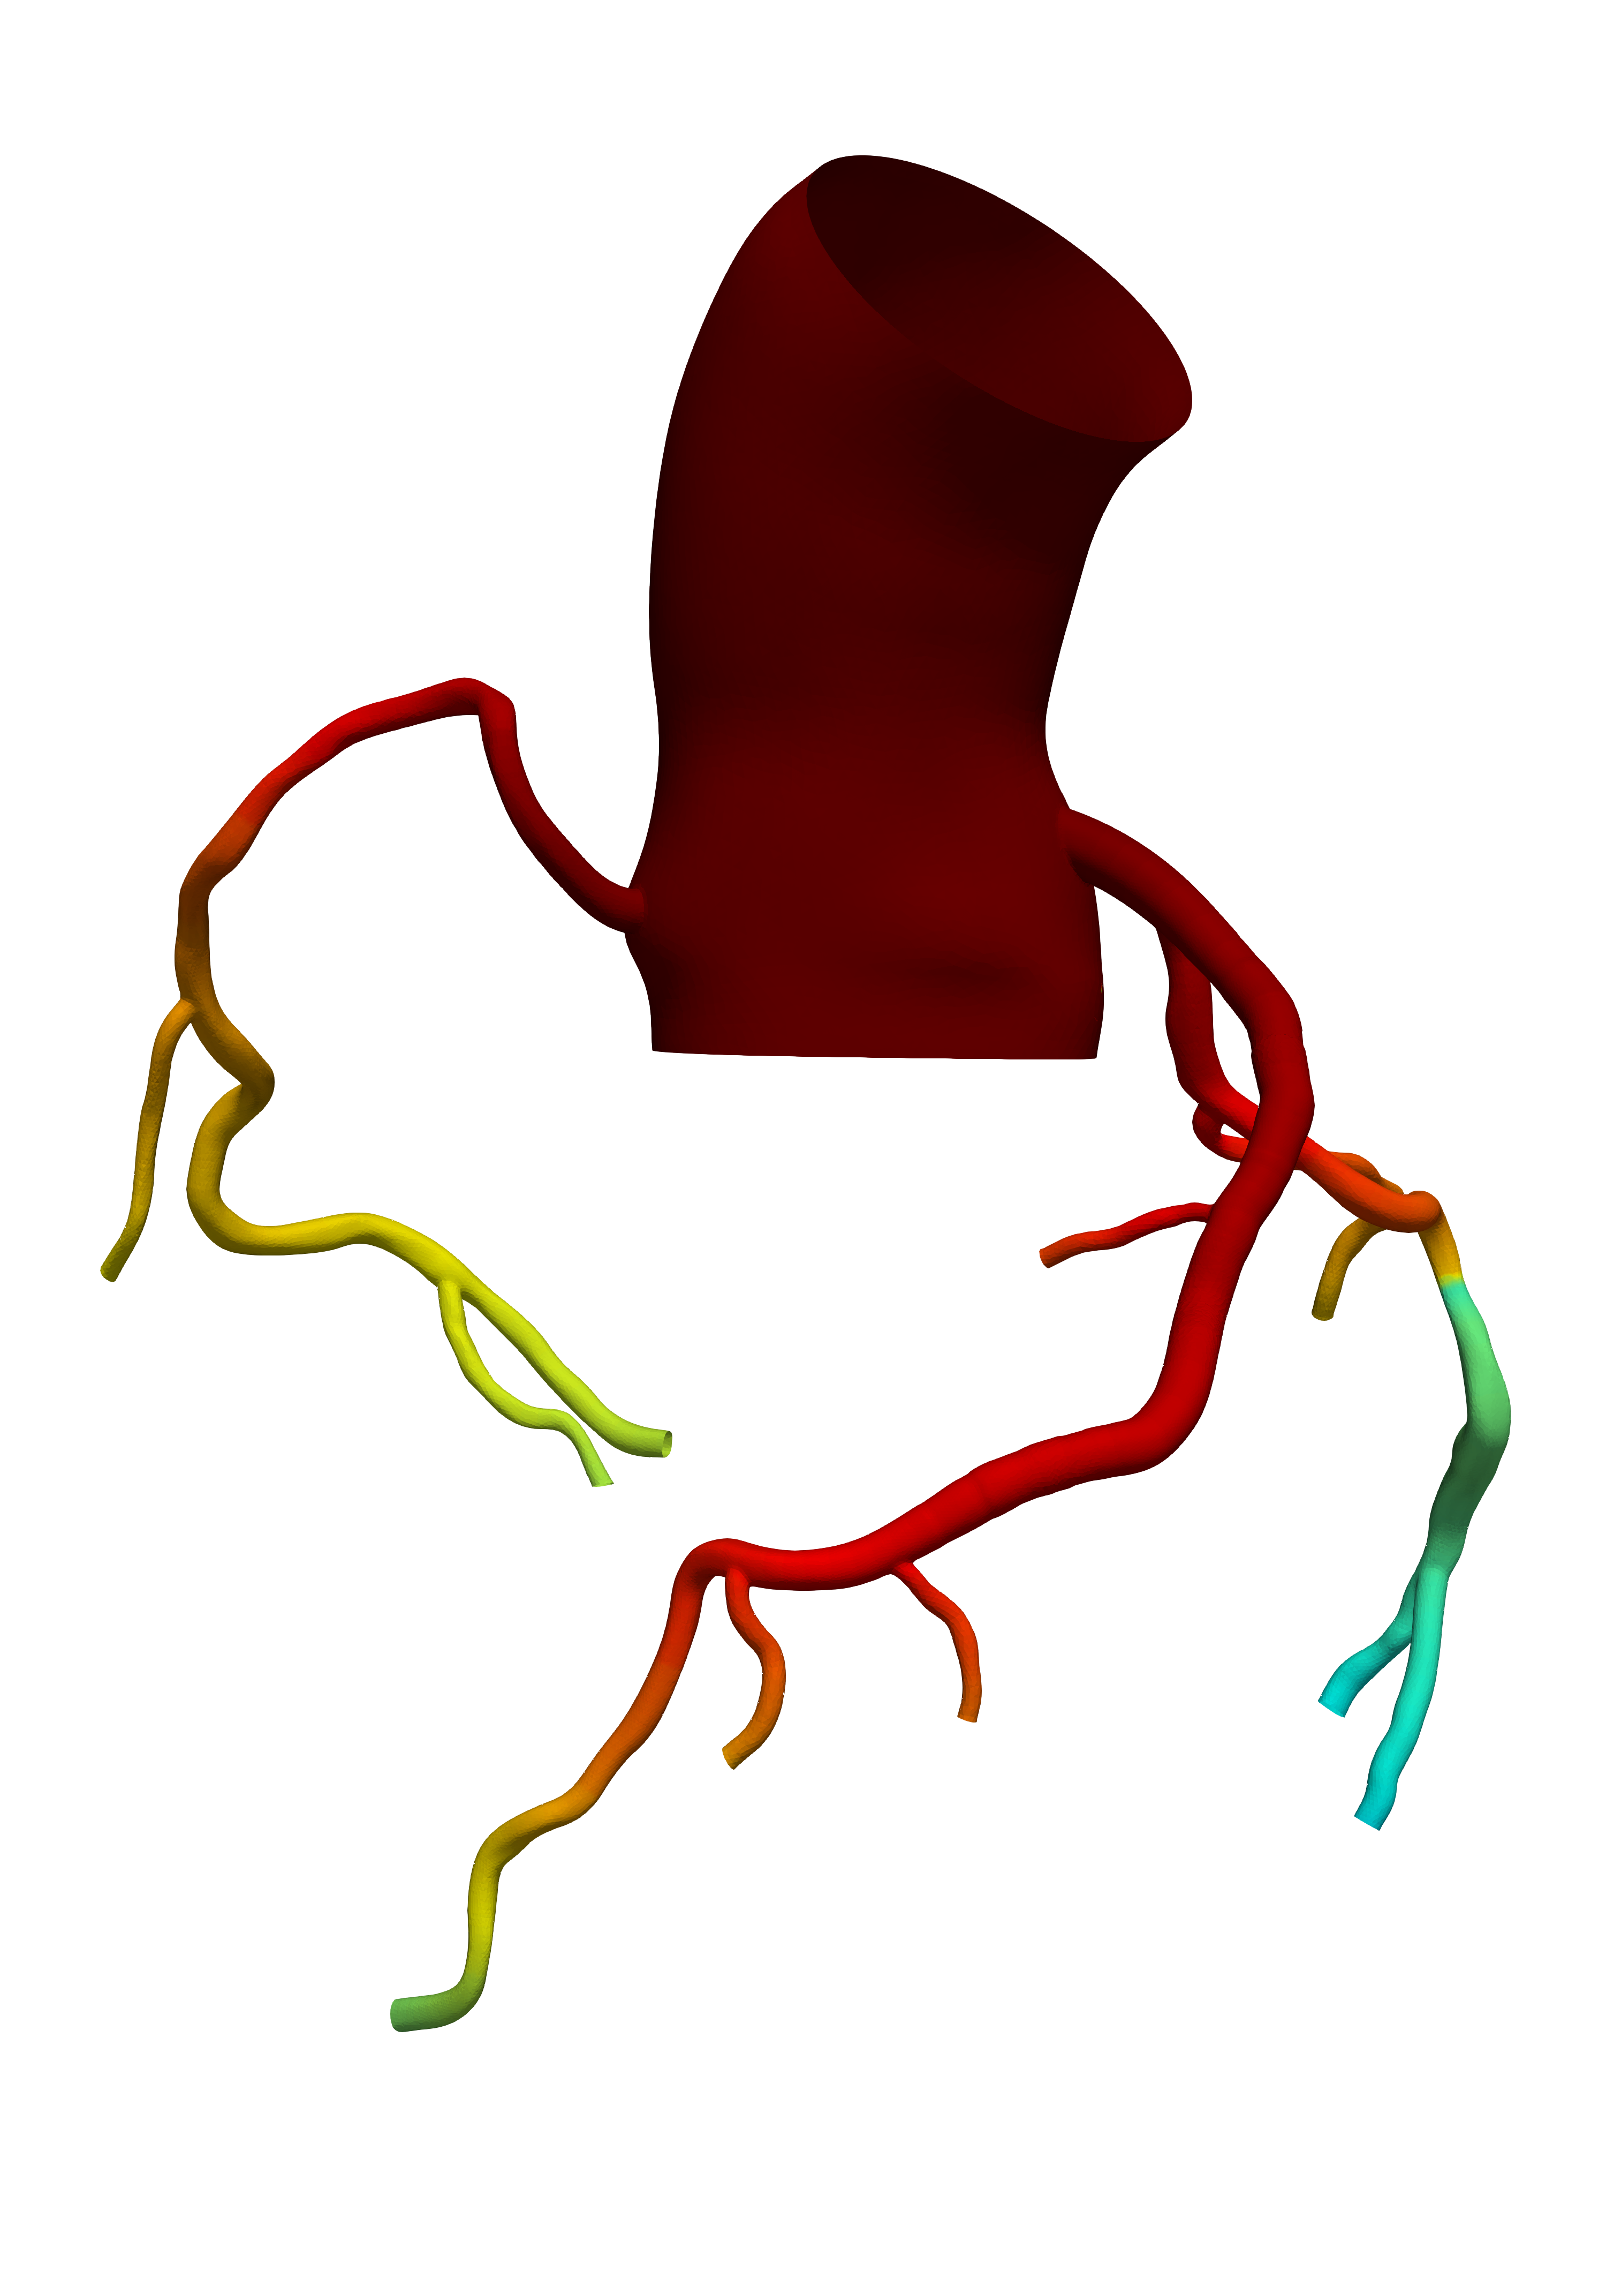
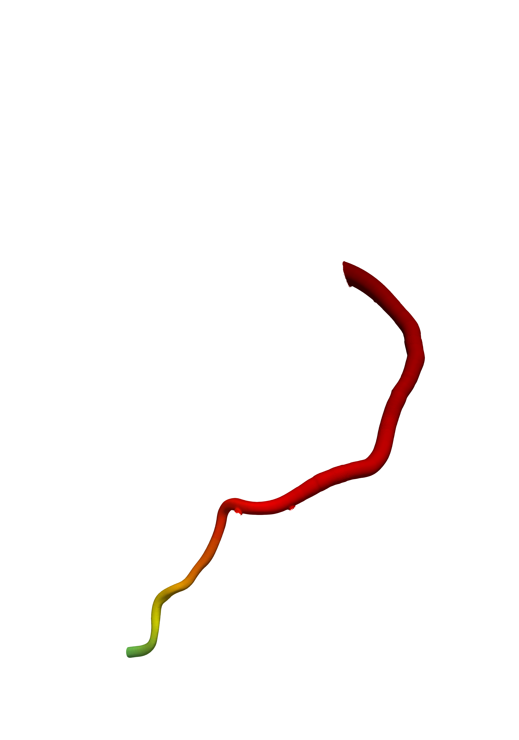
(d) S₁, S₂ and S₃ are stented
FFR_{CT} = 0.97
FFR_{CT} = 0.96
FFR_{CT} = 0.95

Slide 5
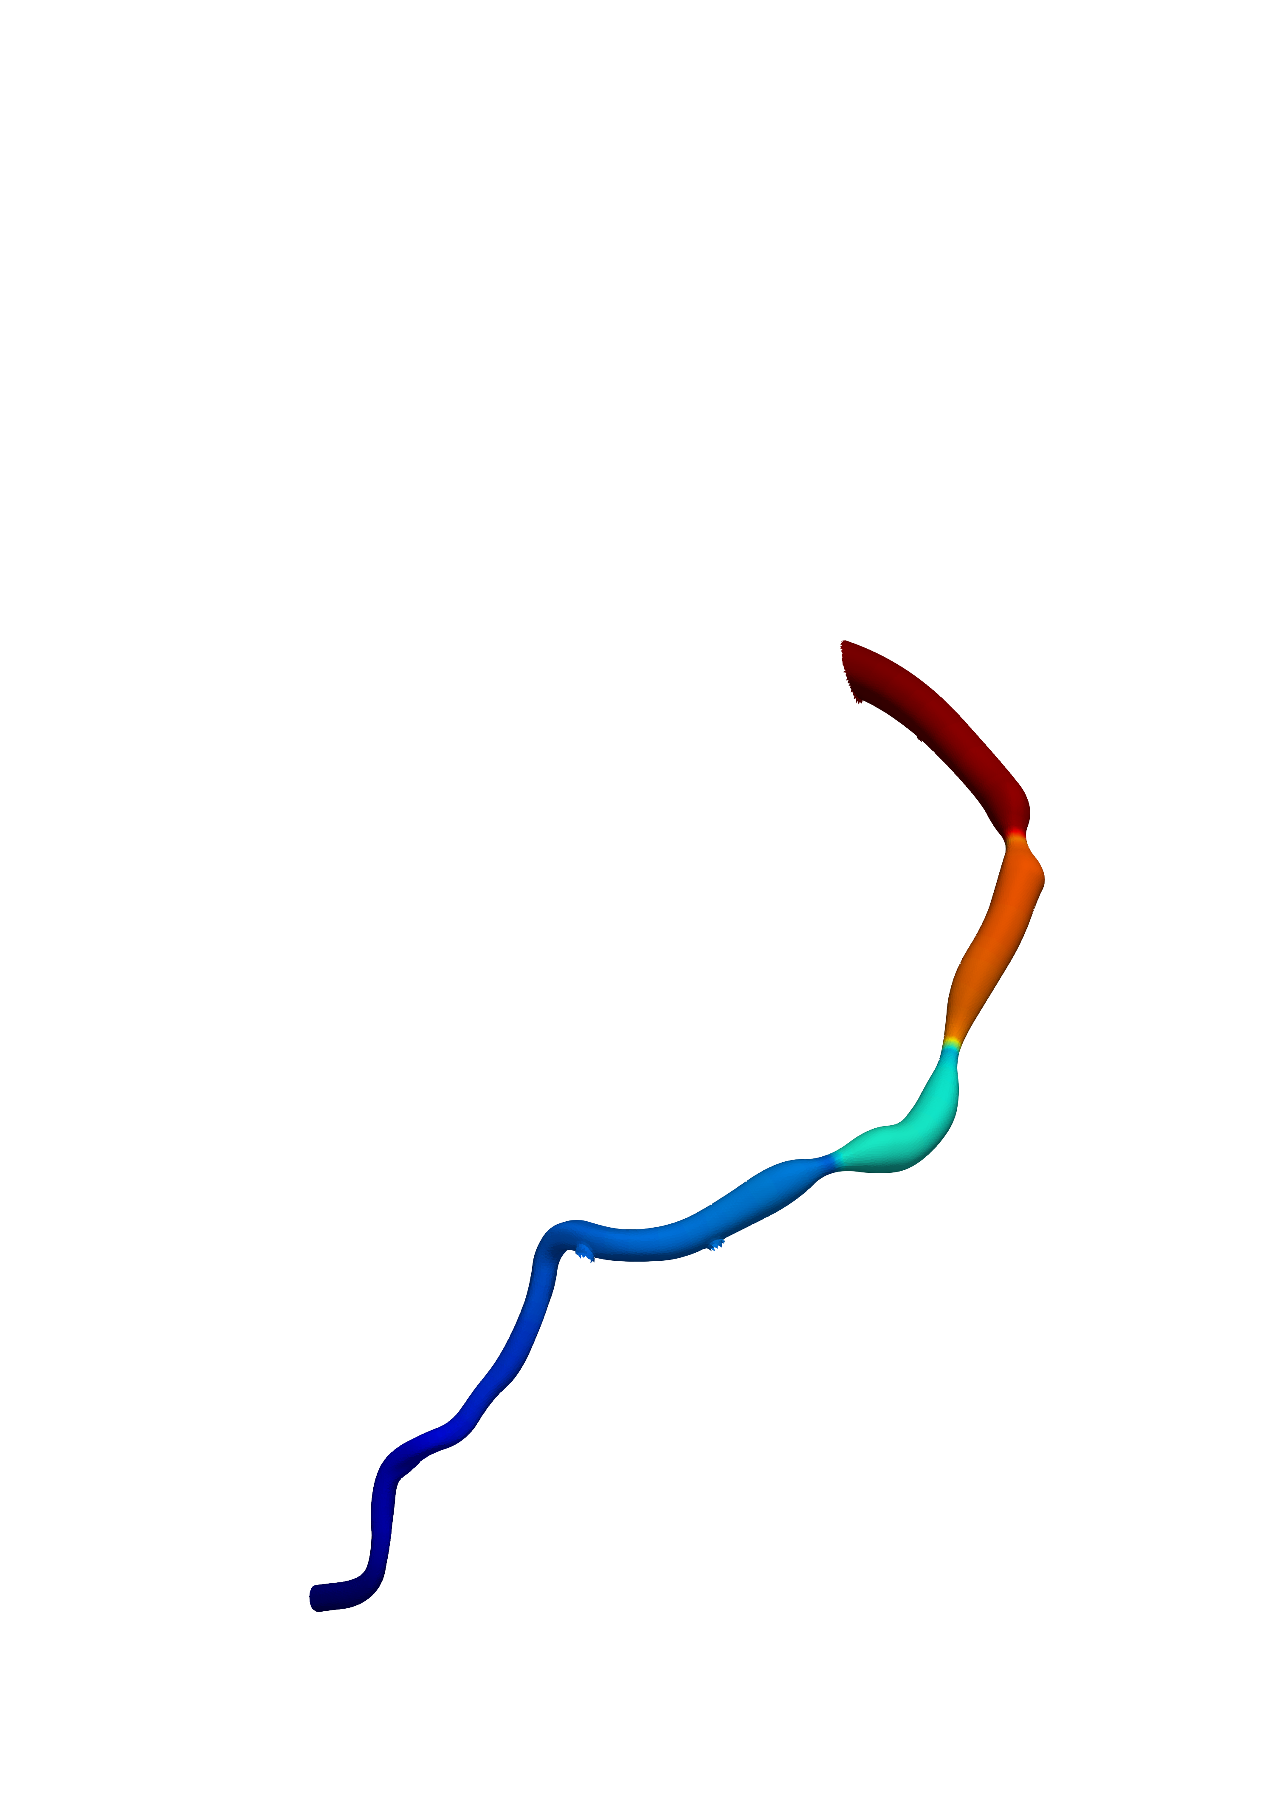
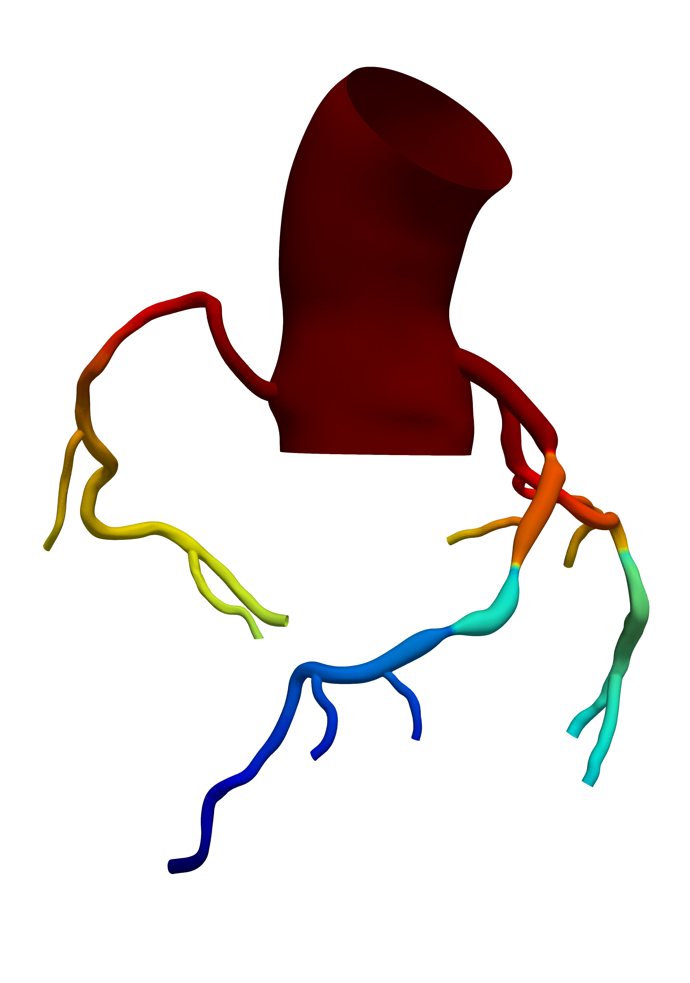
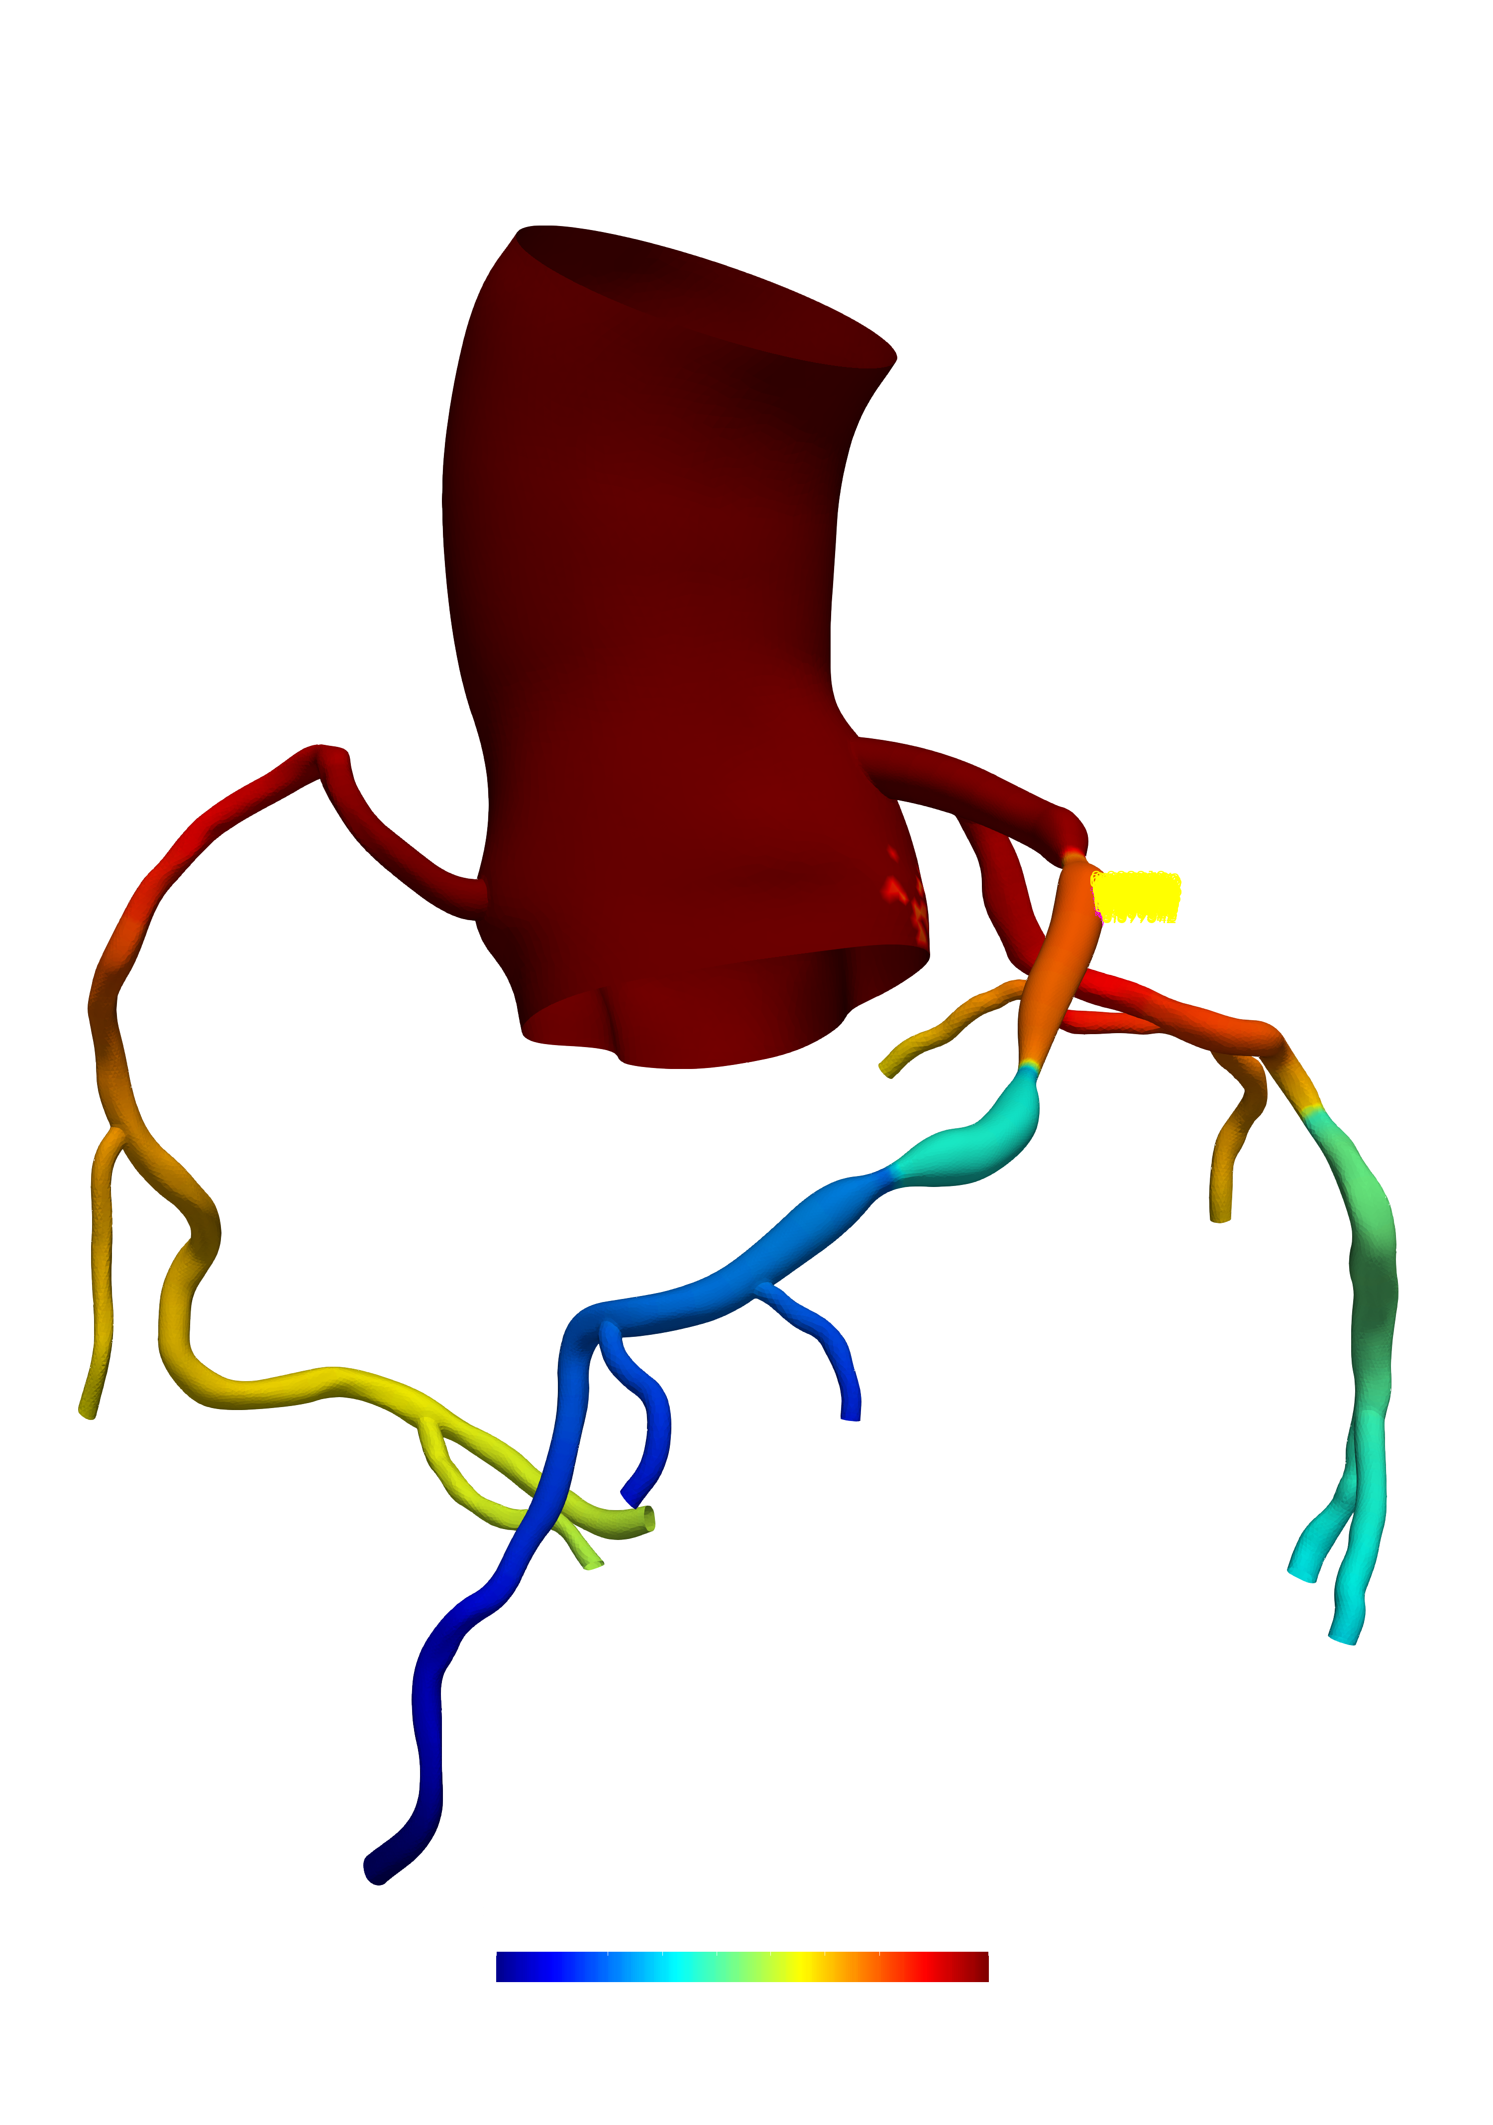
S₁
S₂
FFR = 0.89
S₃
FFR = 0.72
FFR = 0.66
FFR
0.5
1.0

Slide 6
(a) Only S₂ is stented
FFR
0.5
1.0
S₁
S₂
FFR = 0.89
FFR = 0.87
S₃
FFR = 0.72
FFR = 0.86
FFR = 0.66
FFR = 0.78
(b) S₂ and S₃ are stented
(c) S₁ and S₂ are stented
FFR = 0.87
FFR = 0.98
FFR = 0.85
FFR = 0.97
FFR = 0.84
FFR = 0.88

Slide 7
Diseased
Only S₂ is stented
S₂ and S₃ are stented
S₂ and S₃ are stented
FFR
0.5
1.0
S₁
S₂
FFR = 0.89
FFR = 0.87
FFR = 0.87
FFR = 0.98
S₃
FFR = 0.72
FFR = 0.86
FFR = 0.85
FFR = 0.97
FFR = 0.66
FFR = 0.78
FFR = 0.84
FFR = 0.88

Slide 8
Diseased
S₂ and S₃ are stented
S₁ and S₂ are stented
FFR
0.5
1.0
S₁
S₂
FFR = 0.89
FFR = 0.87
FFR = 0.98
S₃
FFR = 0.72
FFR = 0.85
FFR = 0.97
FFR = 0.66
FFR = 0.84
FFR = 0.88

Slide 9
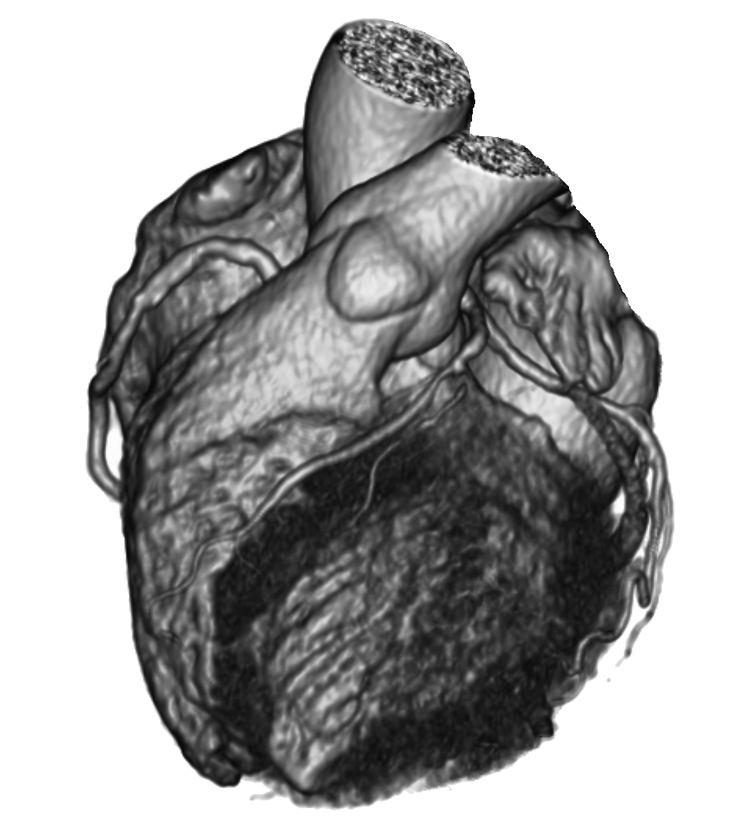
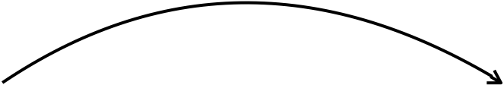

patient’s coronaries
digital twins of coronaries
angioplasty and stenting
data
FFR
0.5
1.0
S₁
S₂
FFR = 0.89
FFR = 0.87
FFR = 0.98
S₃
FFR = 0.72
FFR = 0.85
FFR = 0.97
FFR = 0.66
FFR = 0.84
FFR = 0.88
diseased
S₂ and S₃ are stented
S₁ and S₂ are stented

